Slide 1

Final Project:
Weather Forecasting
Mohamad Aljazaery
Ahmed Cheikh Sidiya
Mohammad Reza Khalghani
Group No. 3

Slide 2
Contents:
1) Introduction
-Problem definition
- The proposed methodology
2) Pre-processing the data
-Handling the missing data
- Normalization
-Aggregating the airports (Clustering Method)
3) Experiments for validation
3.1) Experiments conditions
Error calculation
Default parameters
3.2) The results
Clarify
Results
4) Evaluation
5) Conclusion
6) Future Works

Slide 3
Introduction

Slide 4
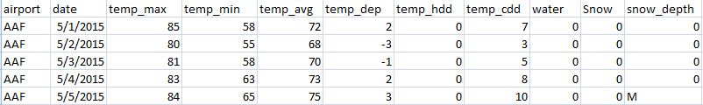
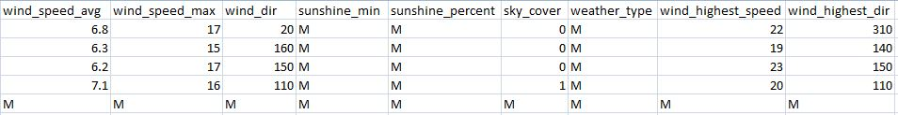
Introduction
Purpose:
Weather forecasting based on data mining methodologies using 749 airports’ data related to weather from May 2015 to October 2015.
Data:

Slide 5
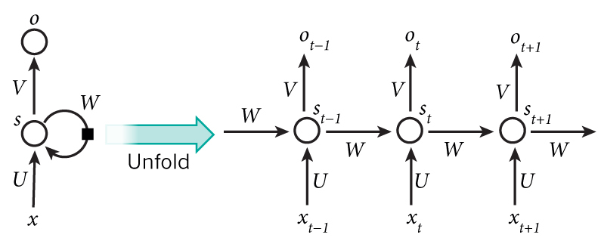
Our Proposed Method
Recurrent Neural Network (RNN):
The idea behind RNNs is to make use of sequential information

Slide 6
Pre-processing the data

Slide 7
Pre-processing the data
1) Handling the missing data
Taking the average value of the data.
Attributes | temp_max | temp_min | temp_avg | temp_dep | temp_hdd | temp_cdd
Missing Data (%) | 0 | 0 | 0 | 8 | 0 | 0
Attributes | water | Snow | snow_depth | wind_speed_avg | wind_speed_max | wind_dir
Missing Data (%) | 11 | 24 | 24 | 0 | 0 | 0
Attributes | sunshine_min | sunshine_percent | sky_cover | weather type | wind highest speed | wind highest dir
Missing Data (%) | 99 | 99 | 2 | 51 | 5 | 6

Slide 8
Pre-processing the data
Normalization:
Normalizing the input values for RNN
Speed up the learning
Remove the dependence on measurement units
Prevent weights from being overly adjusted due to the possible large magnitudes of measured predictor variable values

Slide 9


Pre-processing the data
2) Normalization
Min-Max Normalization
Z-score Normalization
=+1
=-1
Why “-1”? 1) Proper for neural network 2) We had an attribute having negative values

Slide 10
Pre-processing the data
3) Aggregating the airports (Clustering Method)
The target: Magnifying the data with the other airports close to each other in terms of geographical position (It is supposed that these airports have similar climate pattern).
The methodology: K-means
The dimensions for this clustering: Latitude and Longitude
The number of clusters: 20 clusters

Slide 11
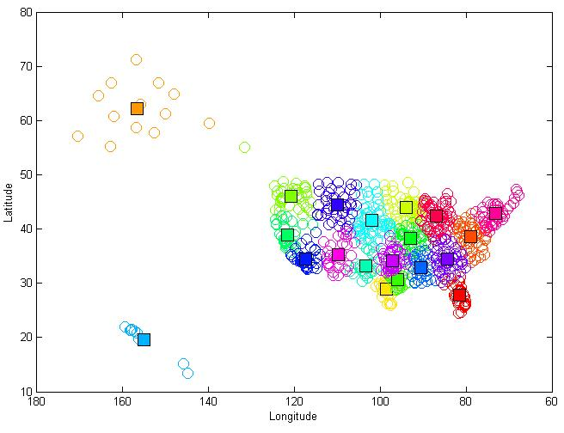
Pre-processing the data
3) Aggregating the airports (Clustering Method)

Slide 12
Experiments for validation

Slide 13
Experiments For Validation
Experiment Conditions
Fixed parameters:
Activation function: tanh
TESTING_PERCENTAGE: 10
600 Epoch training
Variable Parameters :
Hidden Layers : 10
Normalization: zscore
Features : All
Past Days : 7 days
Segmentations: clustering

Slide 14

Experiments For Validation
Experiment Conditions
Error Calculation : For Maximum and Minimum Temperature, the following formula is used:

Slide 15
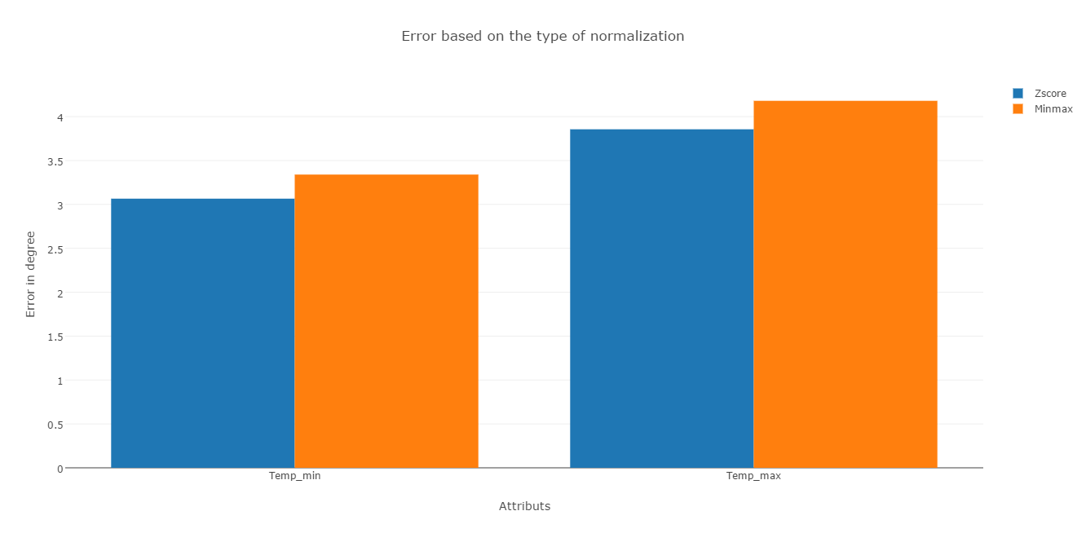
Experiments For Validation
3-1) Experiment Conditions
1) Normalization
Z-score
2) MinMax

Slide 16
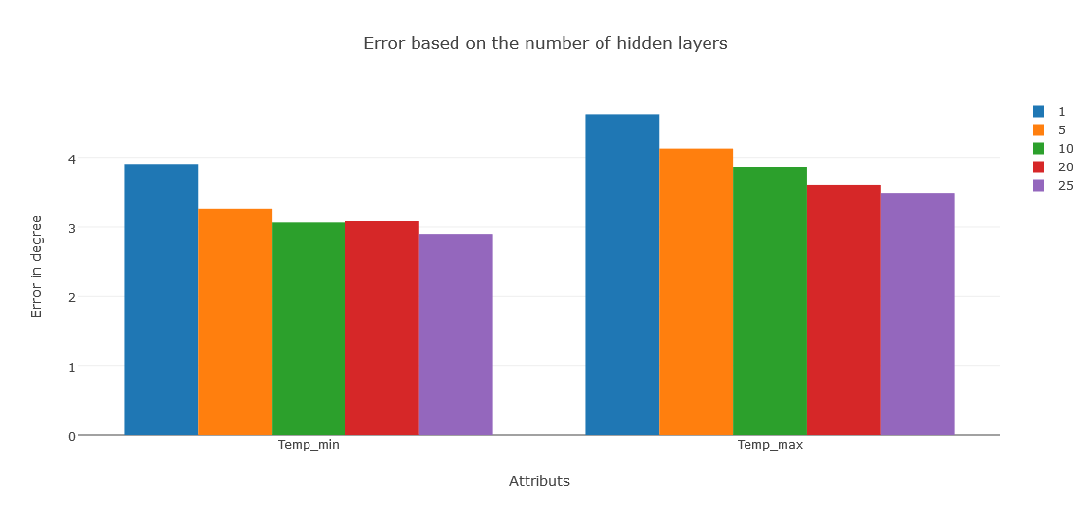
Experiments For Validation
Experiment Conditions
2) The number of hidden layers: # 1, 5, 10, 20, and 25

Slide 17
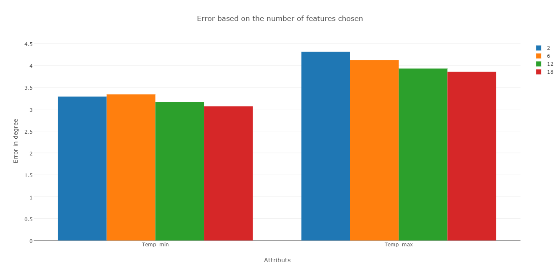
Experiments For Validation
Experiment Conditions
3)The number of selected attributes: # 2, 6, 12 and 18
#2: T_max & T_max
#6: All Temperature attributes
# 12: All Temperature and wind and snow attributes and water

Slide 18
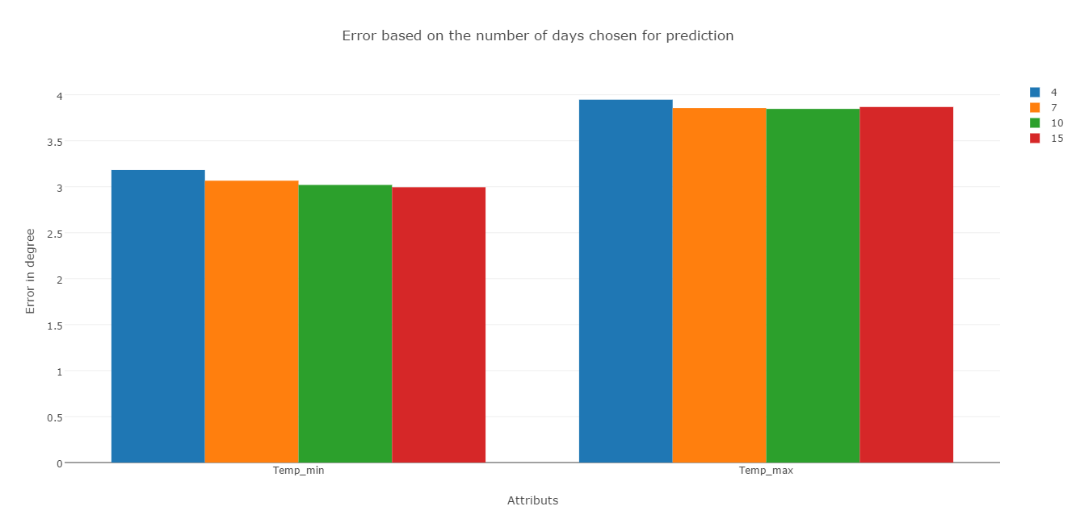
Experiments For Validation
Experiment Conditions
4) The number of selected past days : # 4, 7, 10, 15

Slide 19
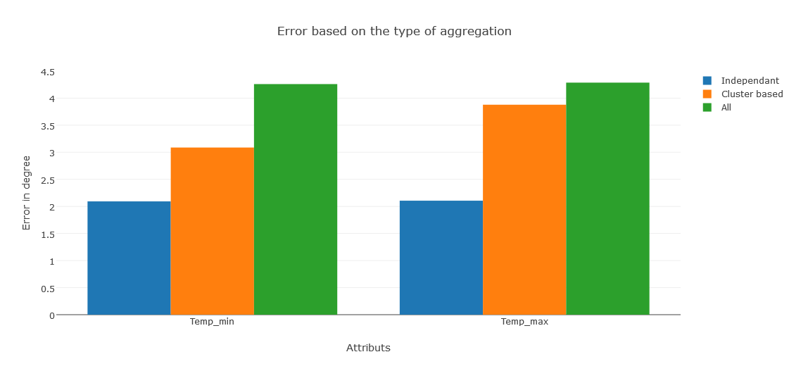
Experiments For Validation
Experiment Conditions
5) The type of aggregation: Independent, Cluster, All

Slide 20
Evaluation

Slide 21
Evaluation
Our Method:
('Hidden Lyers ', 25)
('PAST_DAYS ', 10)
('TESTING_PERCENTAGE ', 10)
('Epochs Num ', 600)
('Normalization ', 'zcore')
ALL Features
Model for each airport
Activation function: tanh
Linear Regression:
Input: All features of 10 days as input
Output: the next day temperature
All data && independent
Intellicast:
Over 100K testing data points

Slide 22
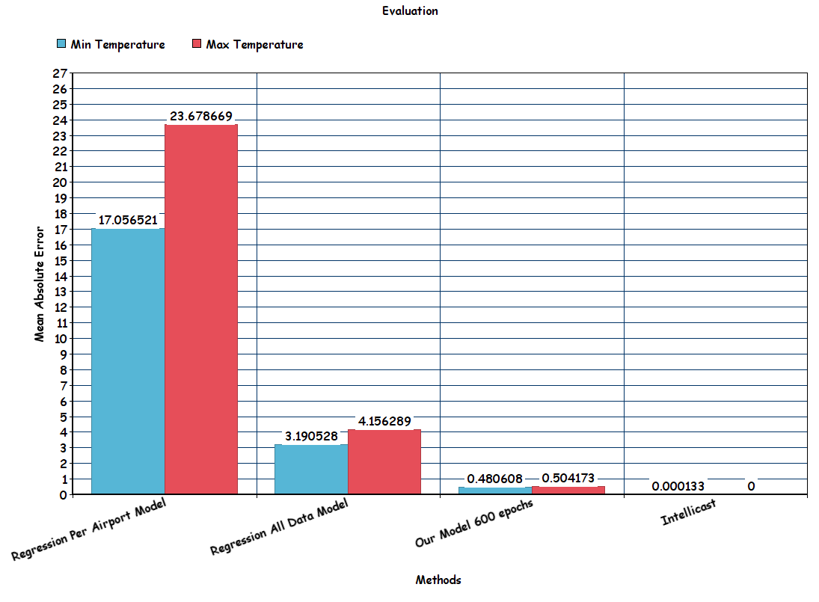
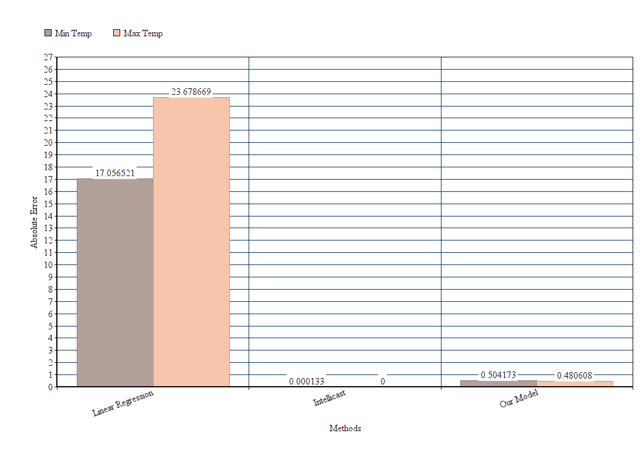
Evaluation

Slide 23
Conclusion

Slide 24
Conclusion
RNN is much much better that Linear regression for time series forecasting
Clustering the data to 20 geographical clusters is not better than using each airports independently
Zscore normalization is better than minmax
Using all the features was helpful, although some features have high missing data percentage

Slide 25
Future Works

Slide 26
Future Works
Use different numbers of clusters (increase)
Use different activation functions
Models combination: Try average prediction from two different models (“clustered data” , “independent”)
Add another dimension to the clustering method (i.e. considering 30 years normal temperature which can be extracted from the data)

Slide 27
References
[1] Jiawei Han, and Micheline Kamber, “Data Mining: Concepts and Techniques”, 3rd edition, 2000.
[2] https://github.com/gwtaylor/theano-rnn
[3] http://www.wildml.com/2015/09/recurrent-neural-networks-tutorial-part-1
-introduction-to-rnns/

Slide 28
Thank You

